Slide 1
Women Empowerment

Slide 2
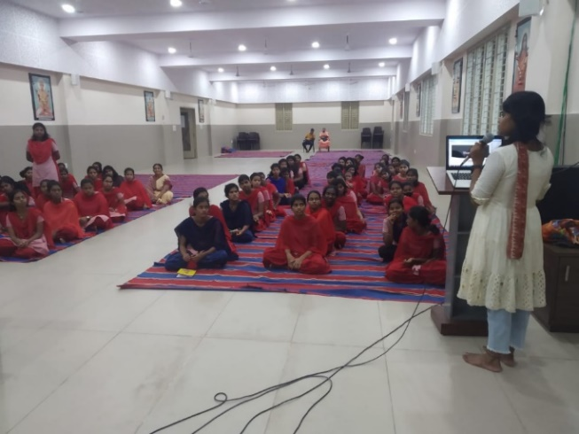
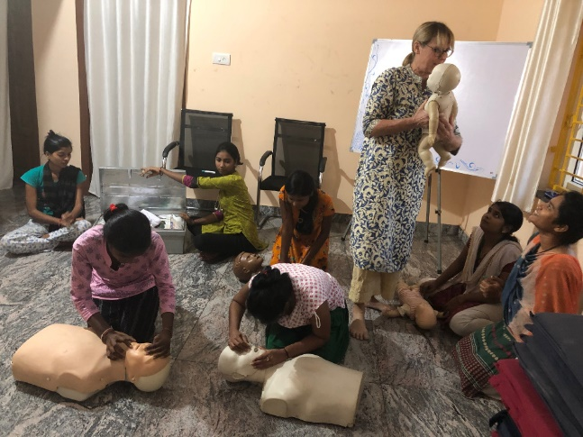
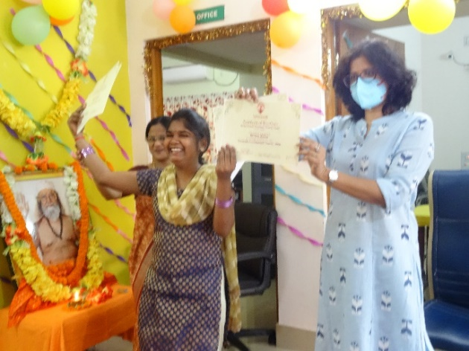
Company MISSION
Grassroots India is a Section 8 non-profit Company, that has the following primary objectives:
To undertake charitable activities for the development of the vulnerable by providing services for emergency relief, basic care (food, water, medicines, housing, etc.), and education
Promote commerce, arts, science, education, religion, public health, and charity
Promote mutual respect through the cooperation of men & women desiring to achieve peace, harmony, and brotherhood
To support pilgrimages to the holy places and to support research into and understanding of religious texts, practices, and symbols
To cooperate with other companies, associations, trusts, and societies having similar aims and objectives
To promote education at all levels and in all streams

Slide 3
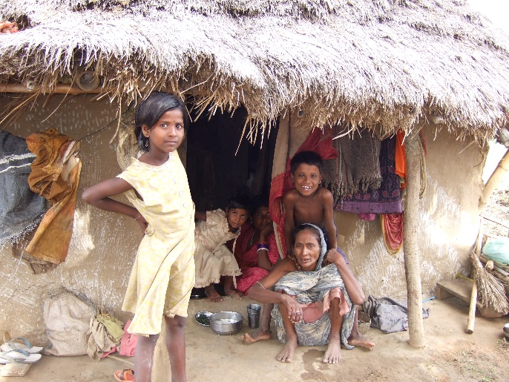
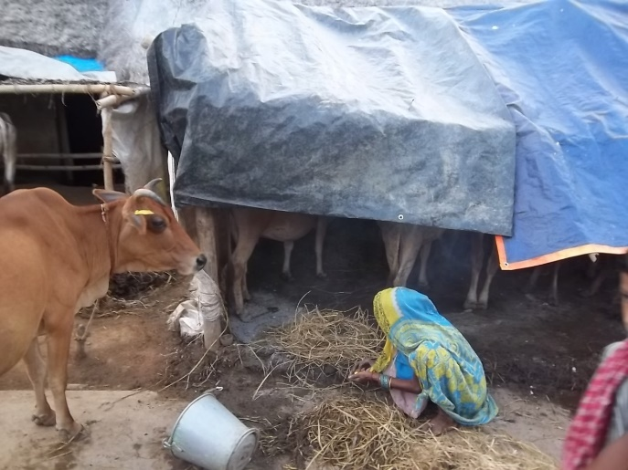
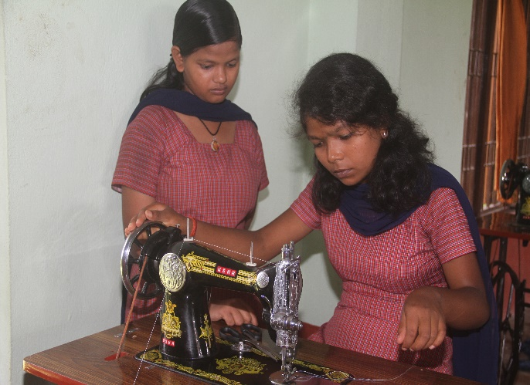
Priorities in Odisha
Promote Gender Equality and Healthy Development of Women in Society
Uplift Women Who Have Been Marginalized and/or Abused
Promote Universal Tolerance for Diversity in Religion and Castes to Promote Community Harmony
Enhance Child Welfare and Protection
Empower Youth to Express Themselves and Be Involved
Offer Under-privileged Women and Children Access to Basic Care, Life Skills and Education
Promote Individual Creativity, Self-Governance and Self-Sufficiency
To promote education at all levels and in all streams
Link Rural Needs With Urban Resources

Slide 4
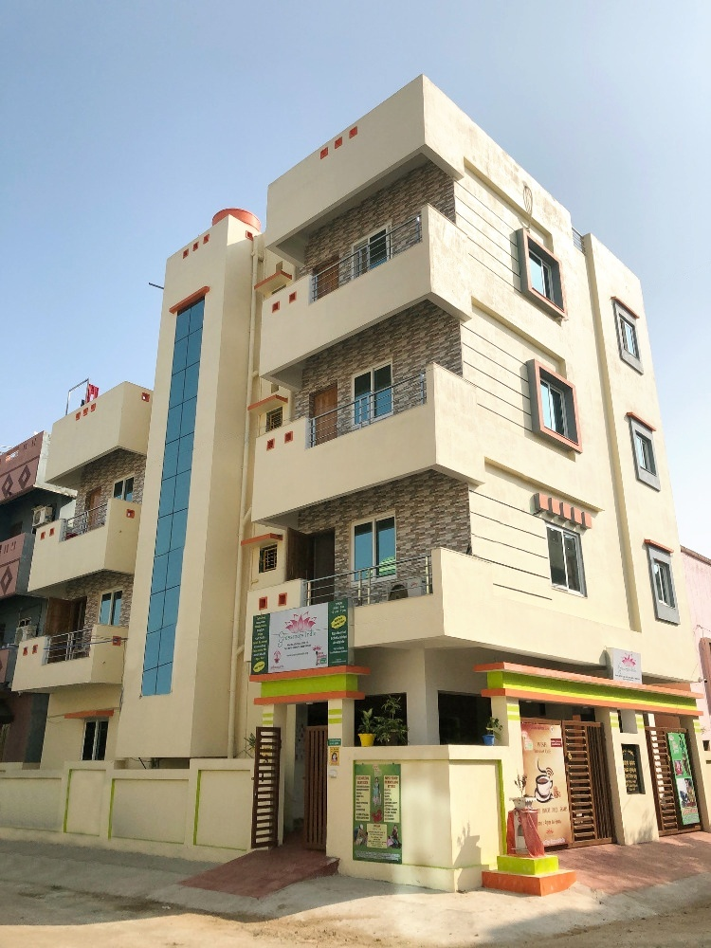
headquarters
Plot No. 5D/1427
CDA Sector 10 Cuttack
Tel: 671-2309577, 9668100520
info@grassrootsindia.org
www.grassrootsindia.org

Slide 5
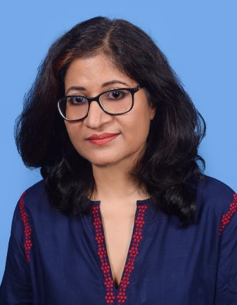
Introduction
Grassroots India has successfully created a cutting-edge vocational & life skill training program for young girls from rural villages in Odisha, India.
The Hariharananda Vocational Training Center (HVTC), located in the town of Cuttack, was founded by Debbie Pennington and Dr. Nivedita Das, and inaugurated by Paramahamsa Prajnananandaji Maharaj in 2008.
The W.I.S.H. Network has enhanced the skills, education, health, livelihood, and life experience of hundreds of children through its collective resources.

Slide 6
Life Skills and Vocational Training

Slide 7
Classes & Workshops
Computer Courses in Windows, MS Office, Akruti, Graphics
Tailoring
First Aid & CPR
Home Nursing & Bedside Assistants
Arts & Culture
Small Business
Spoken English
Life Skills - Finance, House Management, Travel & more…
Women’s Issues / Social Issues
Course Certificates issued upon successful completion

Slide 8
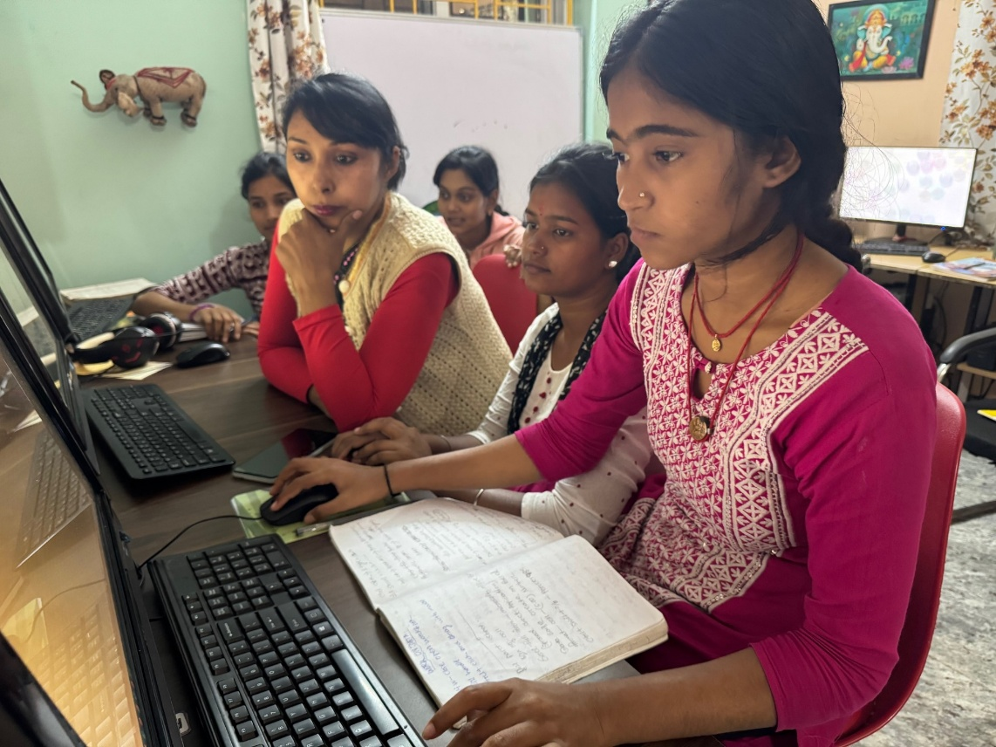
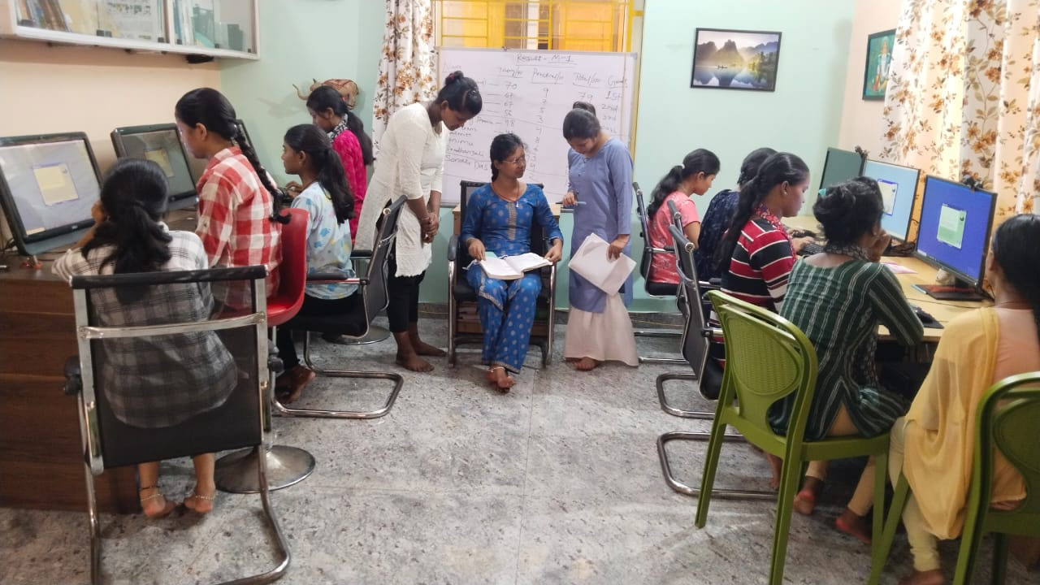
Computer Courses

Slide 9
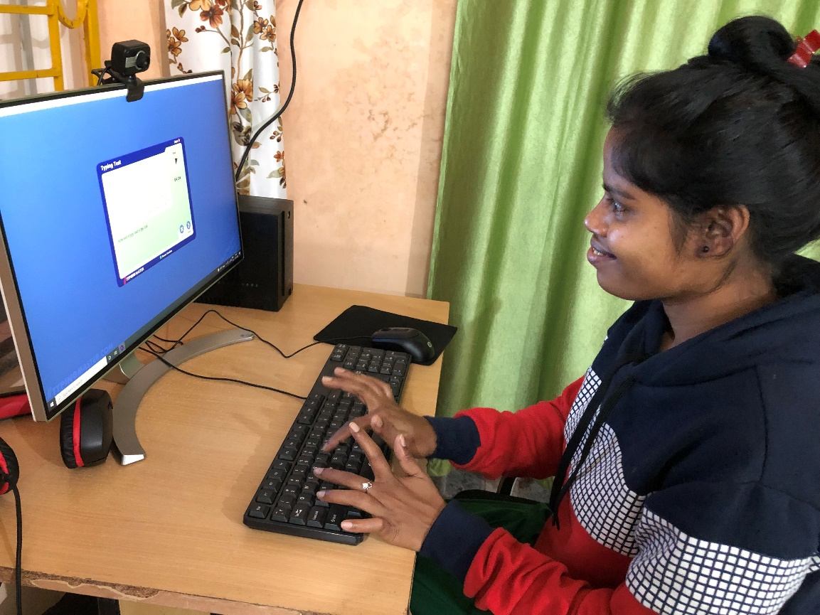
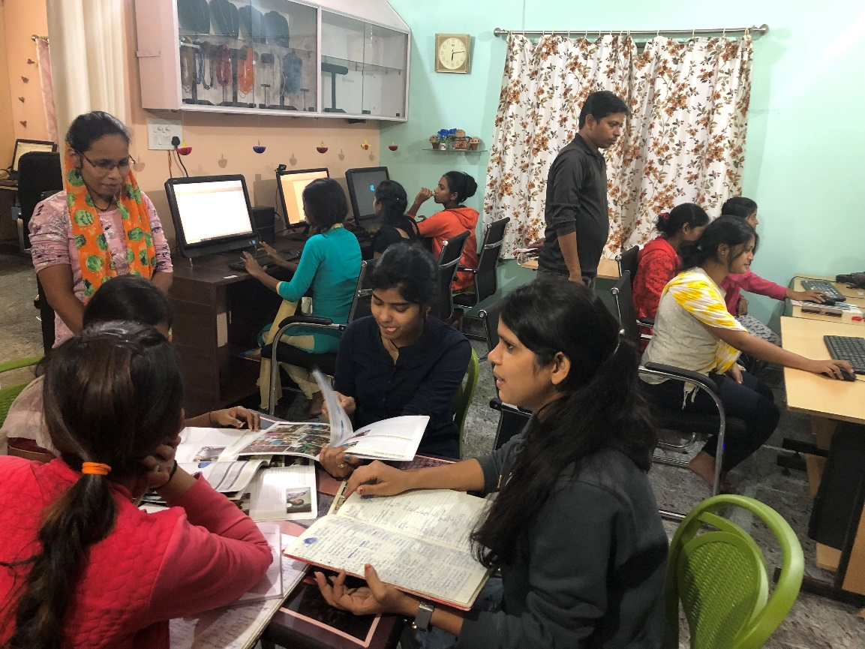
Computer Courses

Slide 10
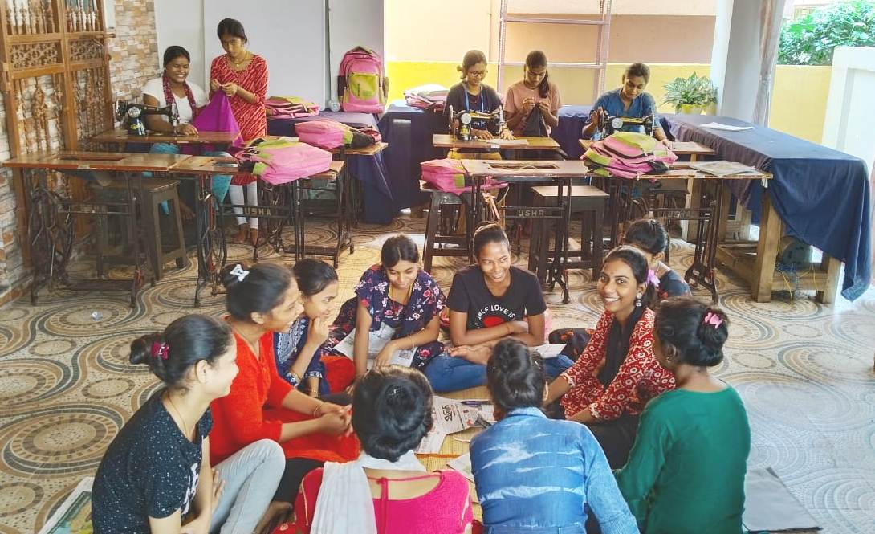
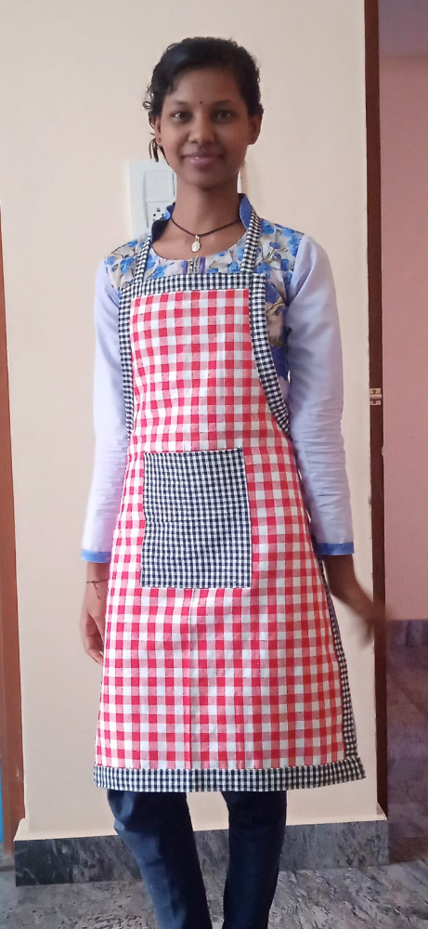
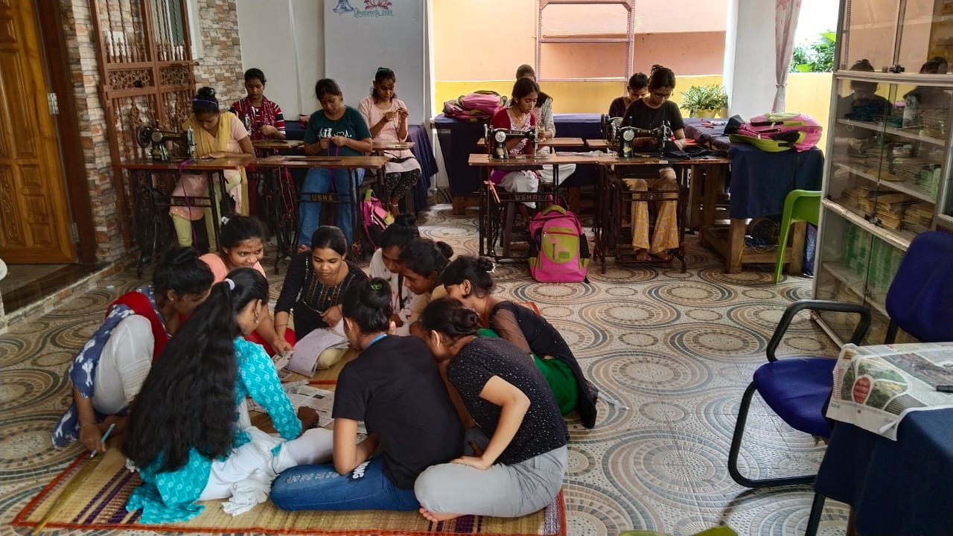
Tailoring

Slide 11
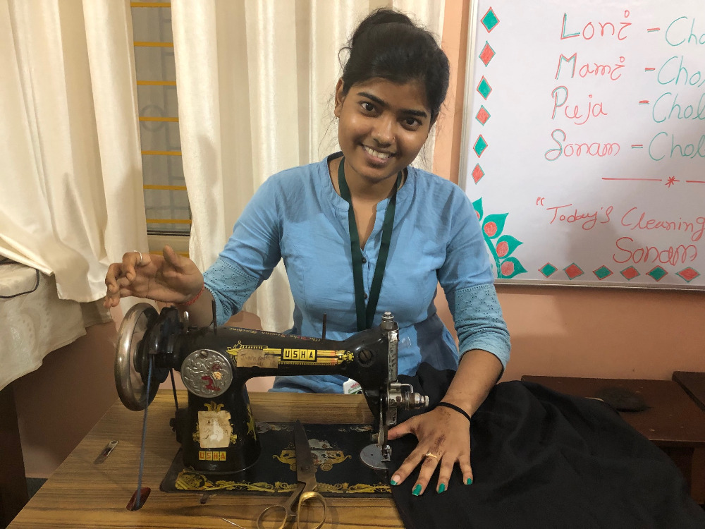
Tailoring

Slide 12
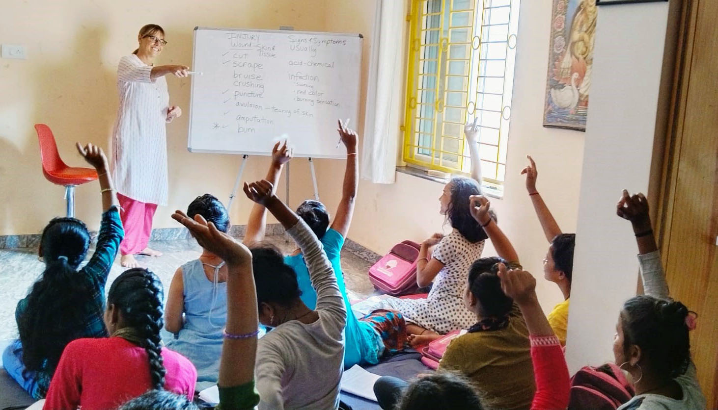
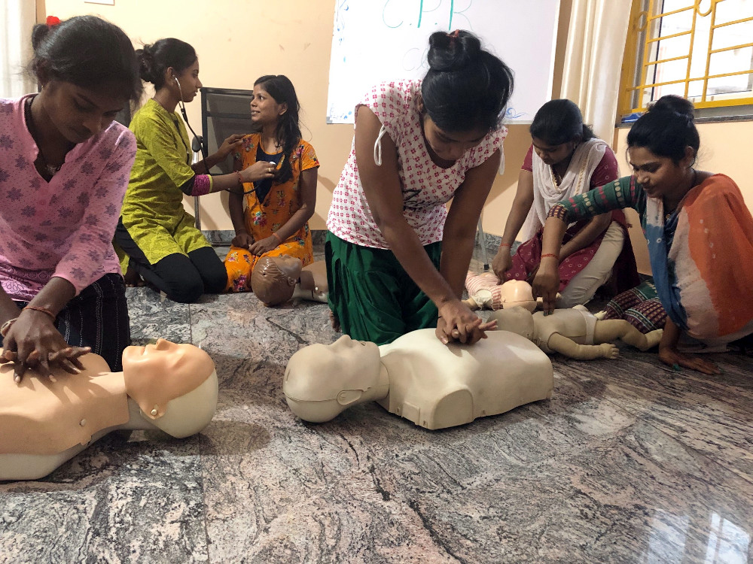
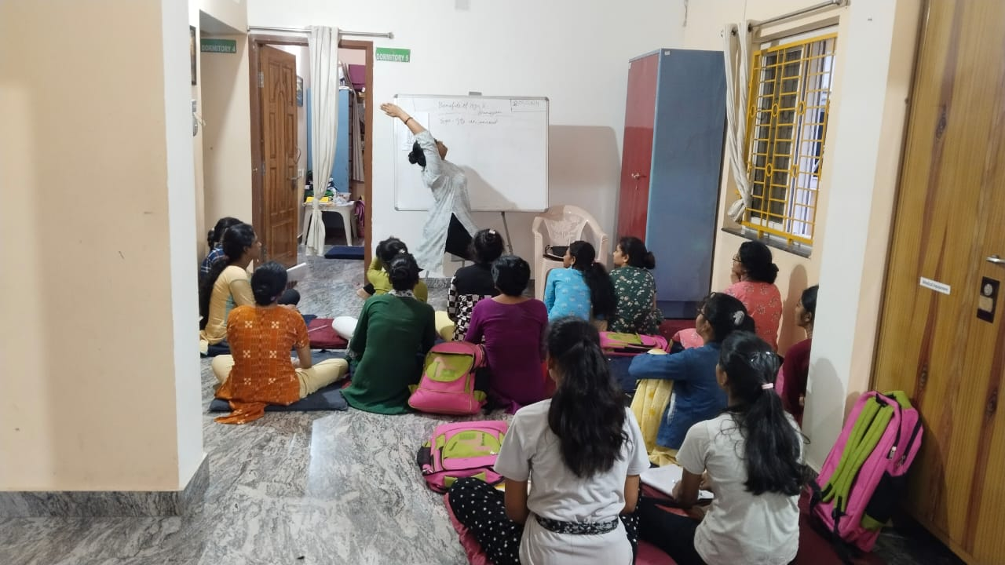
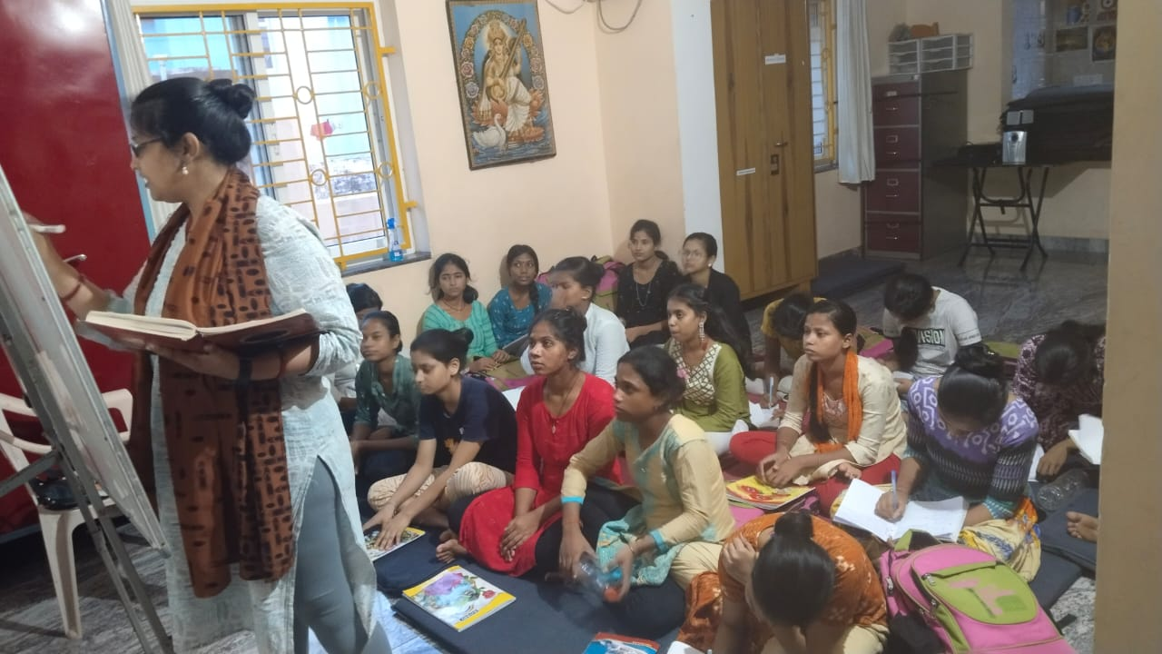
First Aid & CPR Ayurveda

Slide 13
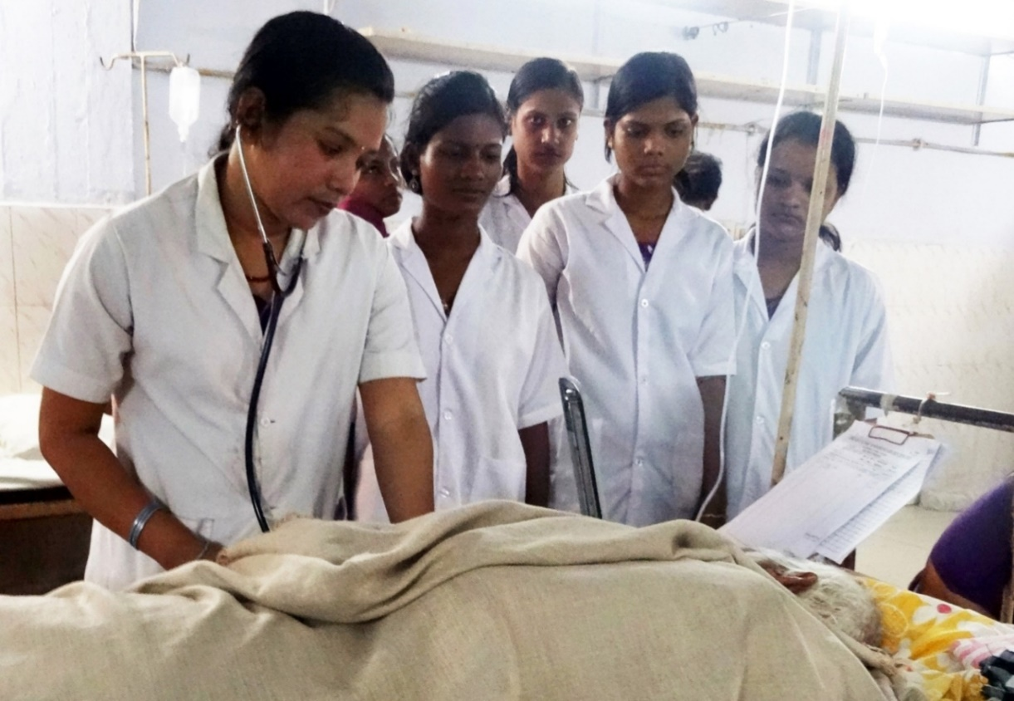
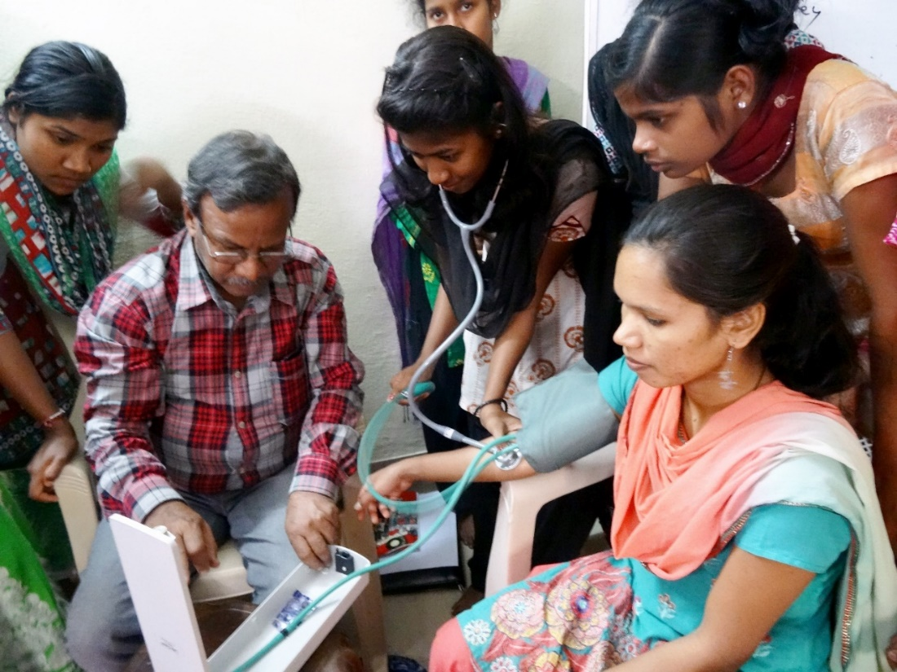
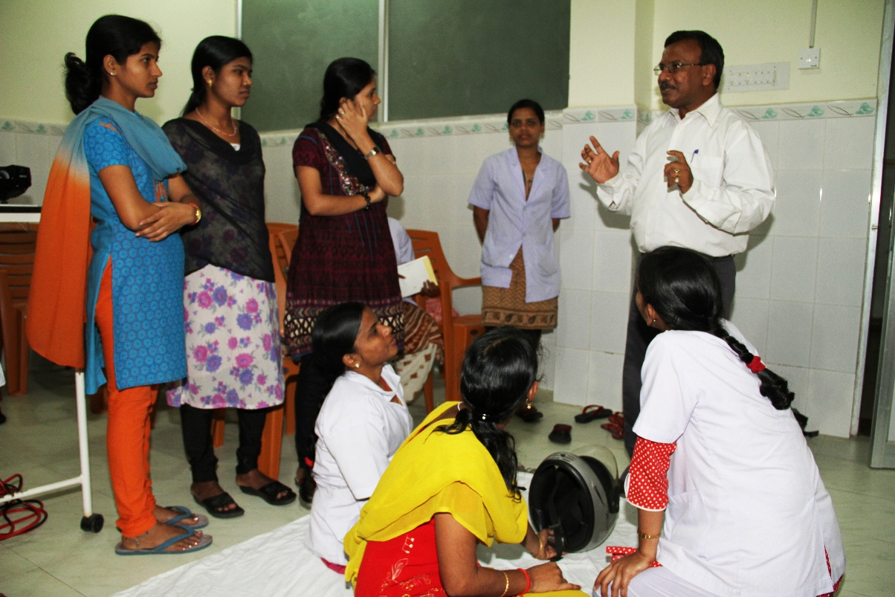
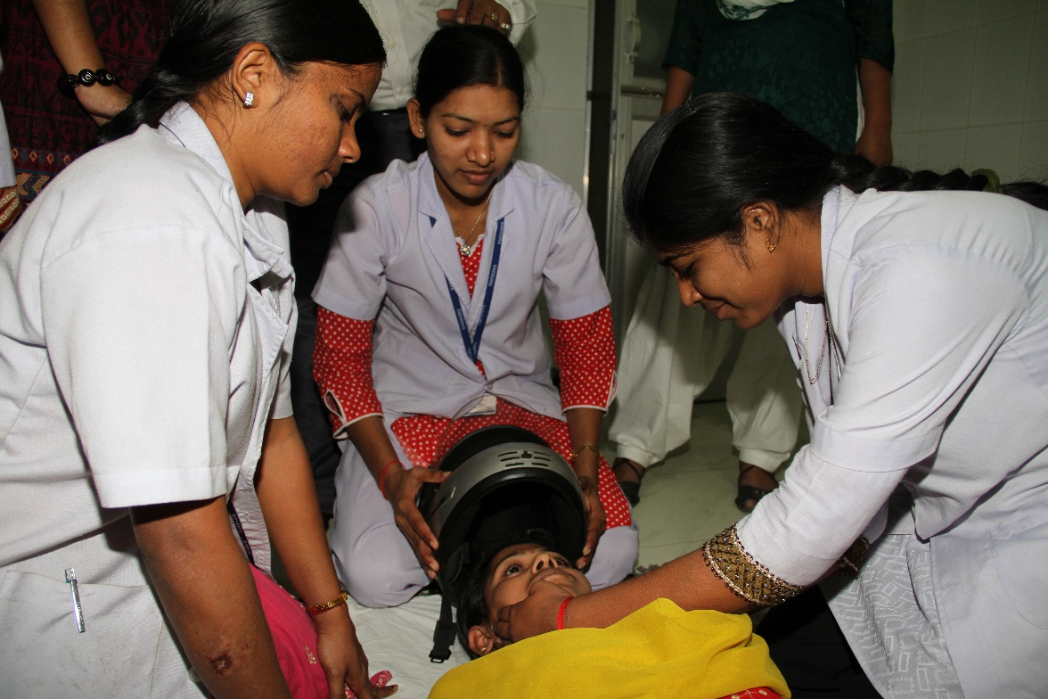
Home Nursing Bedside Assistants

Slide 14
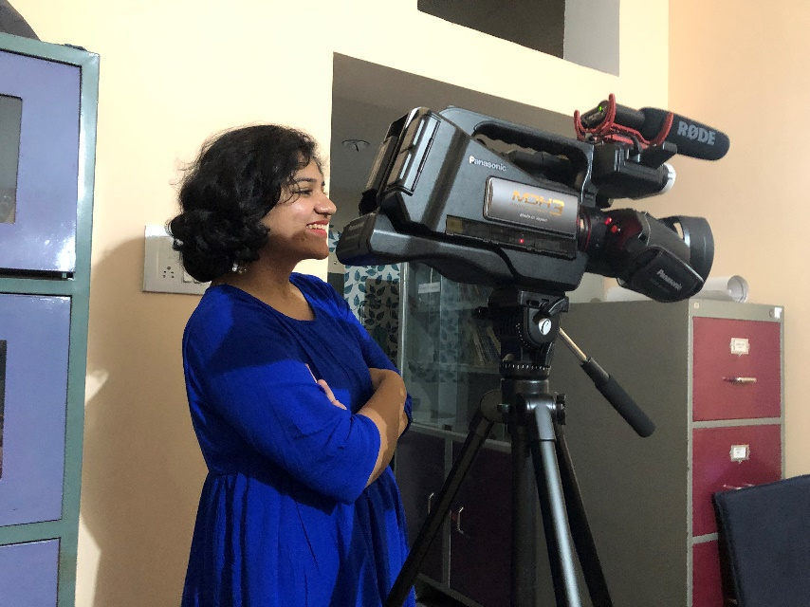
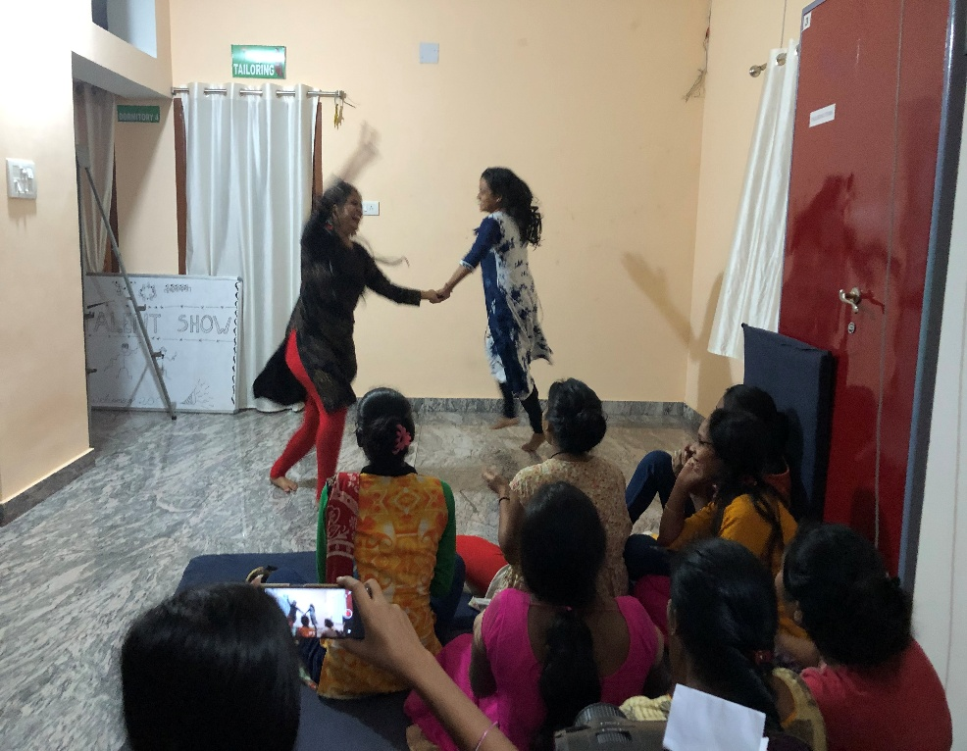
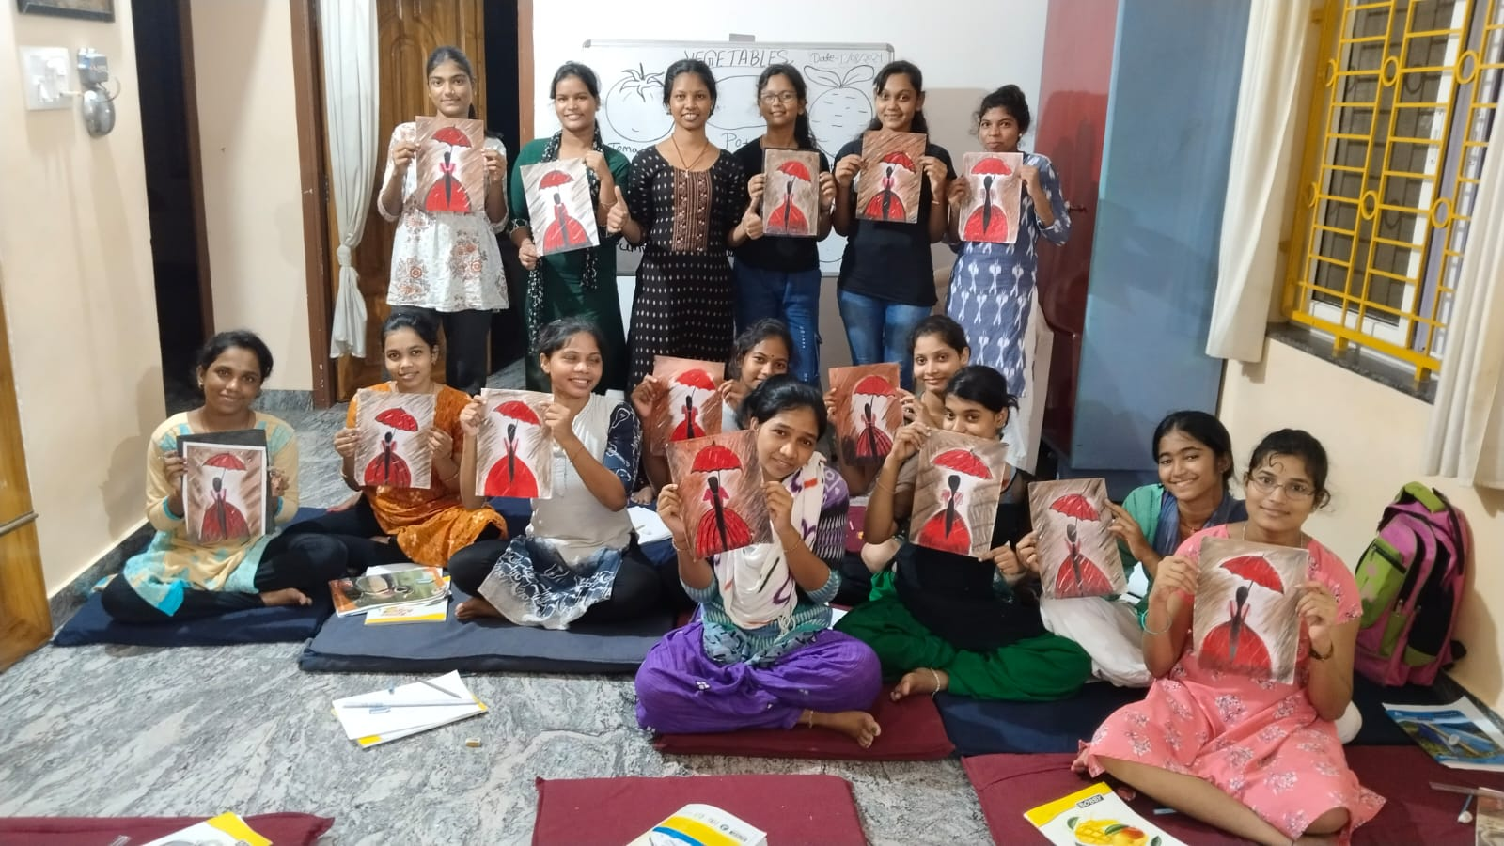
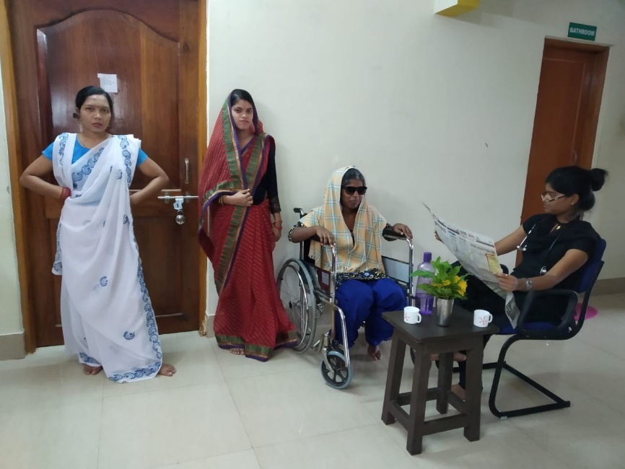
Arts & Culture
Video
Dance
Drawing
Painting
Theater

Slide 15
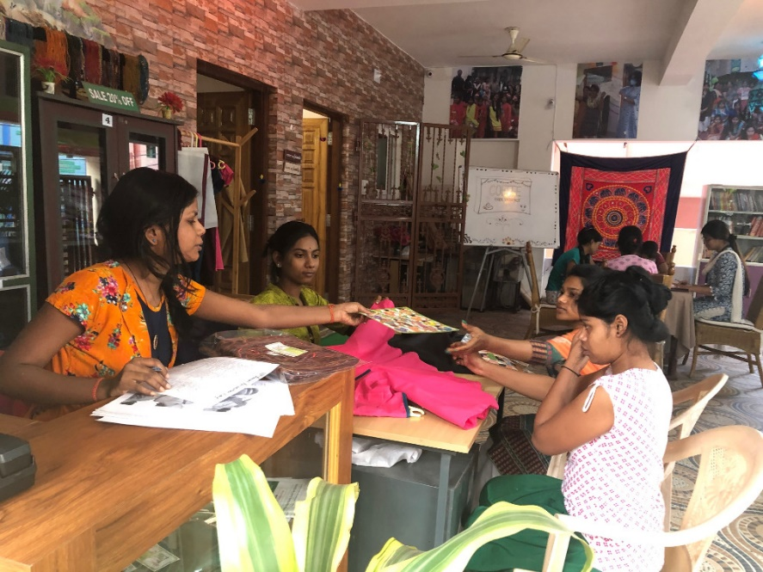
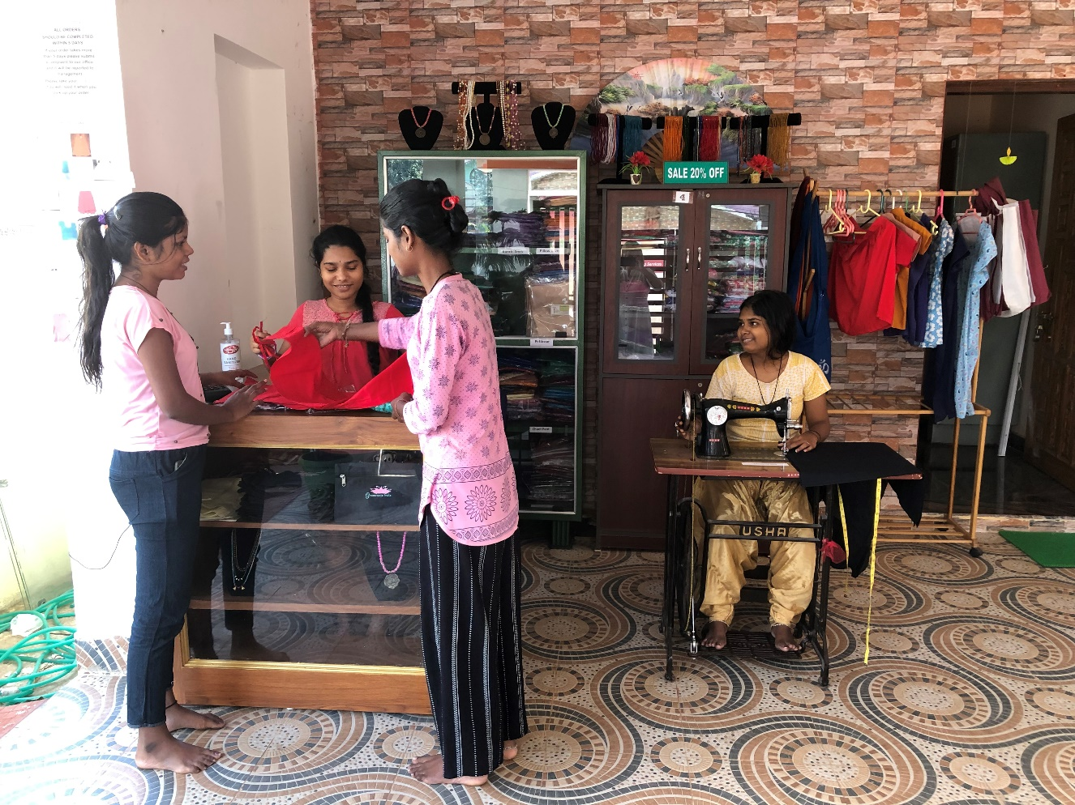
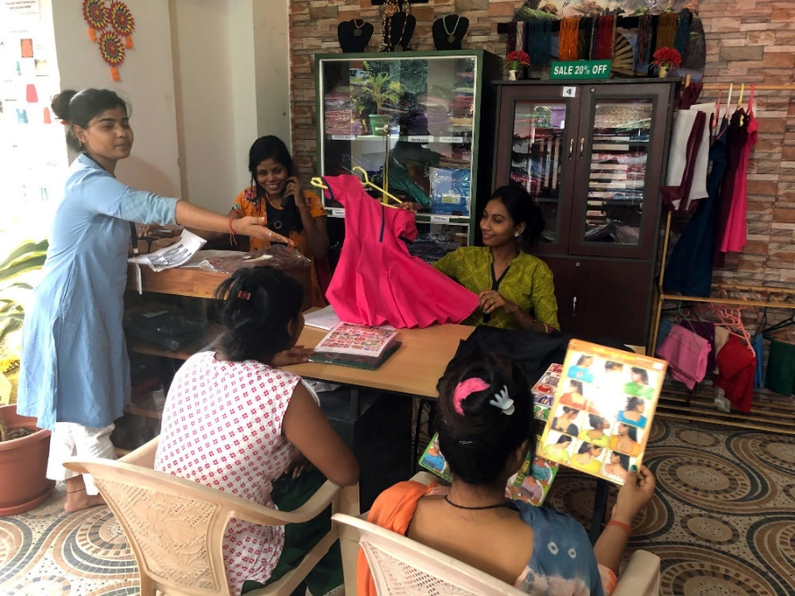
W.I.S.H. Shop Small Business

Slide 16
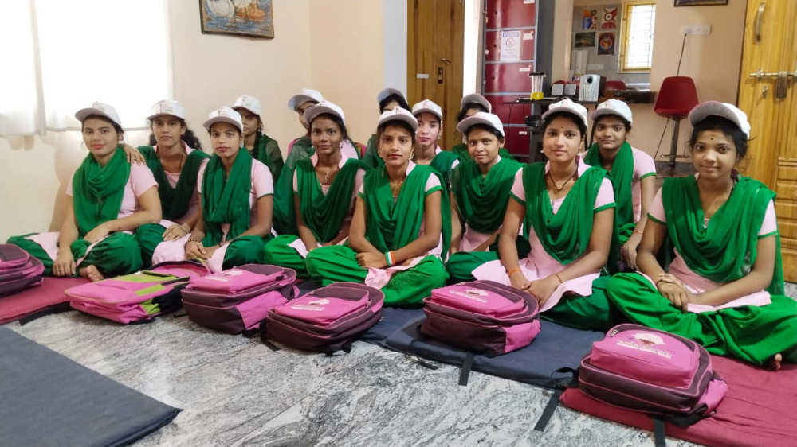
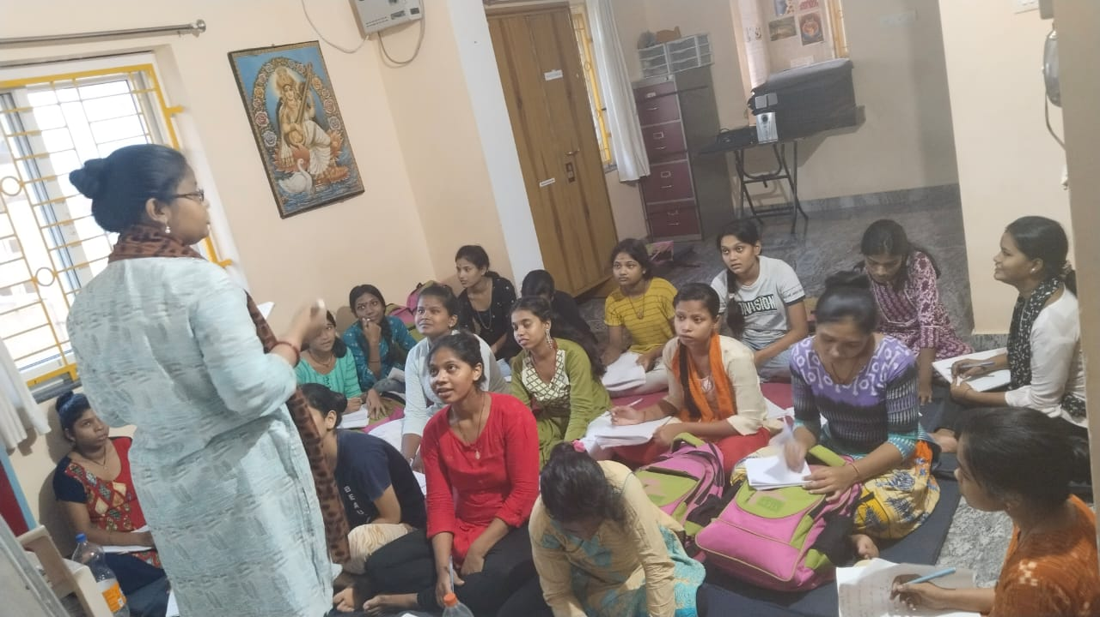
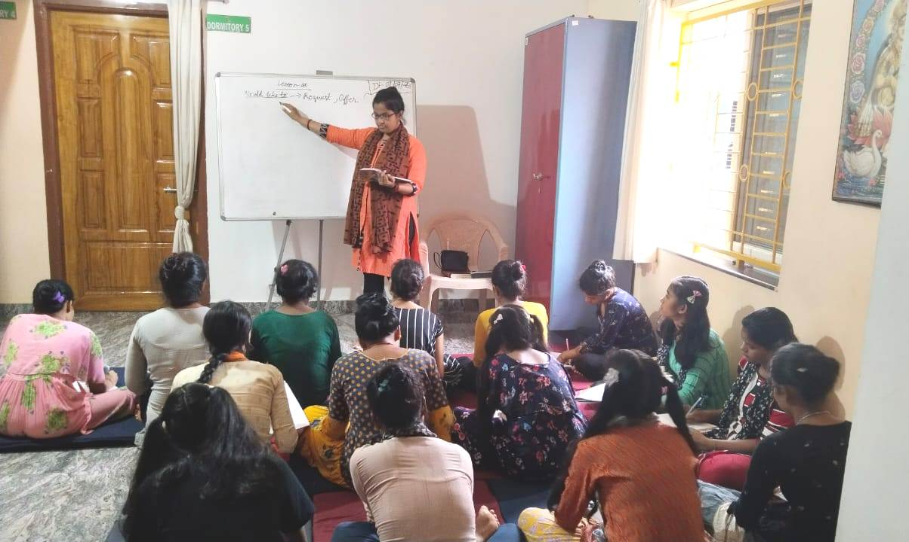
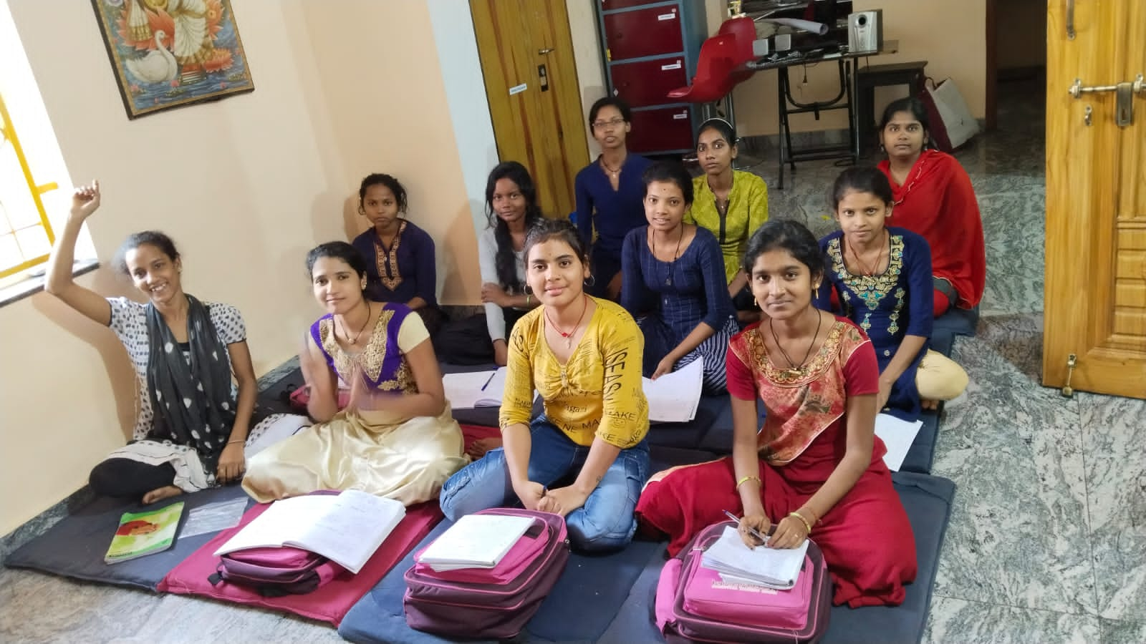
Life Skills Spoken English

Slide 17
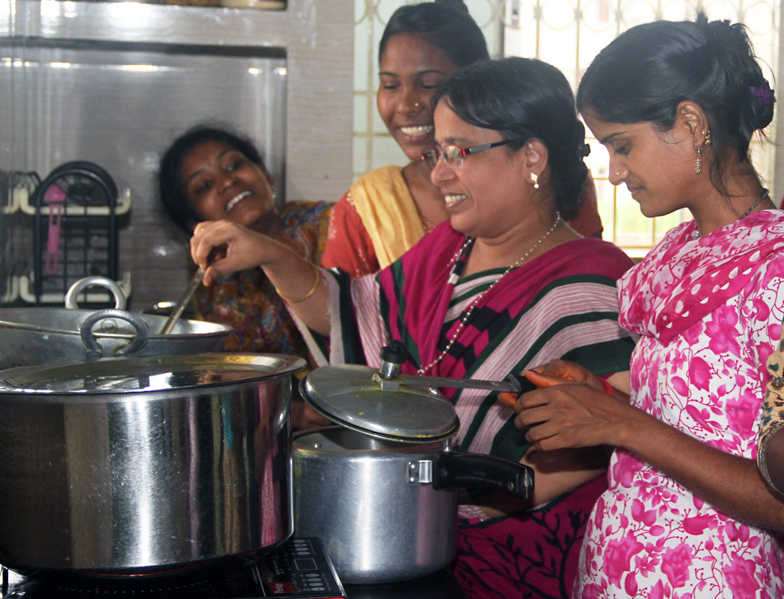
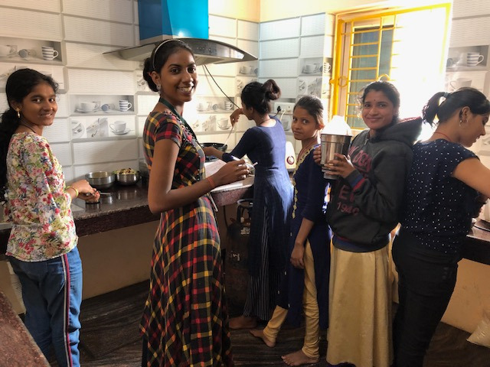
Life Skills Cooking

Slide 18
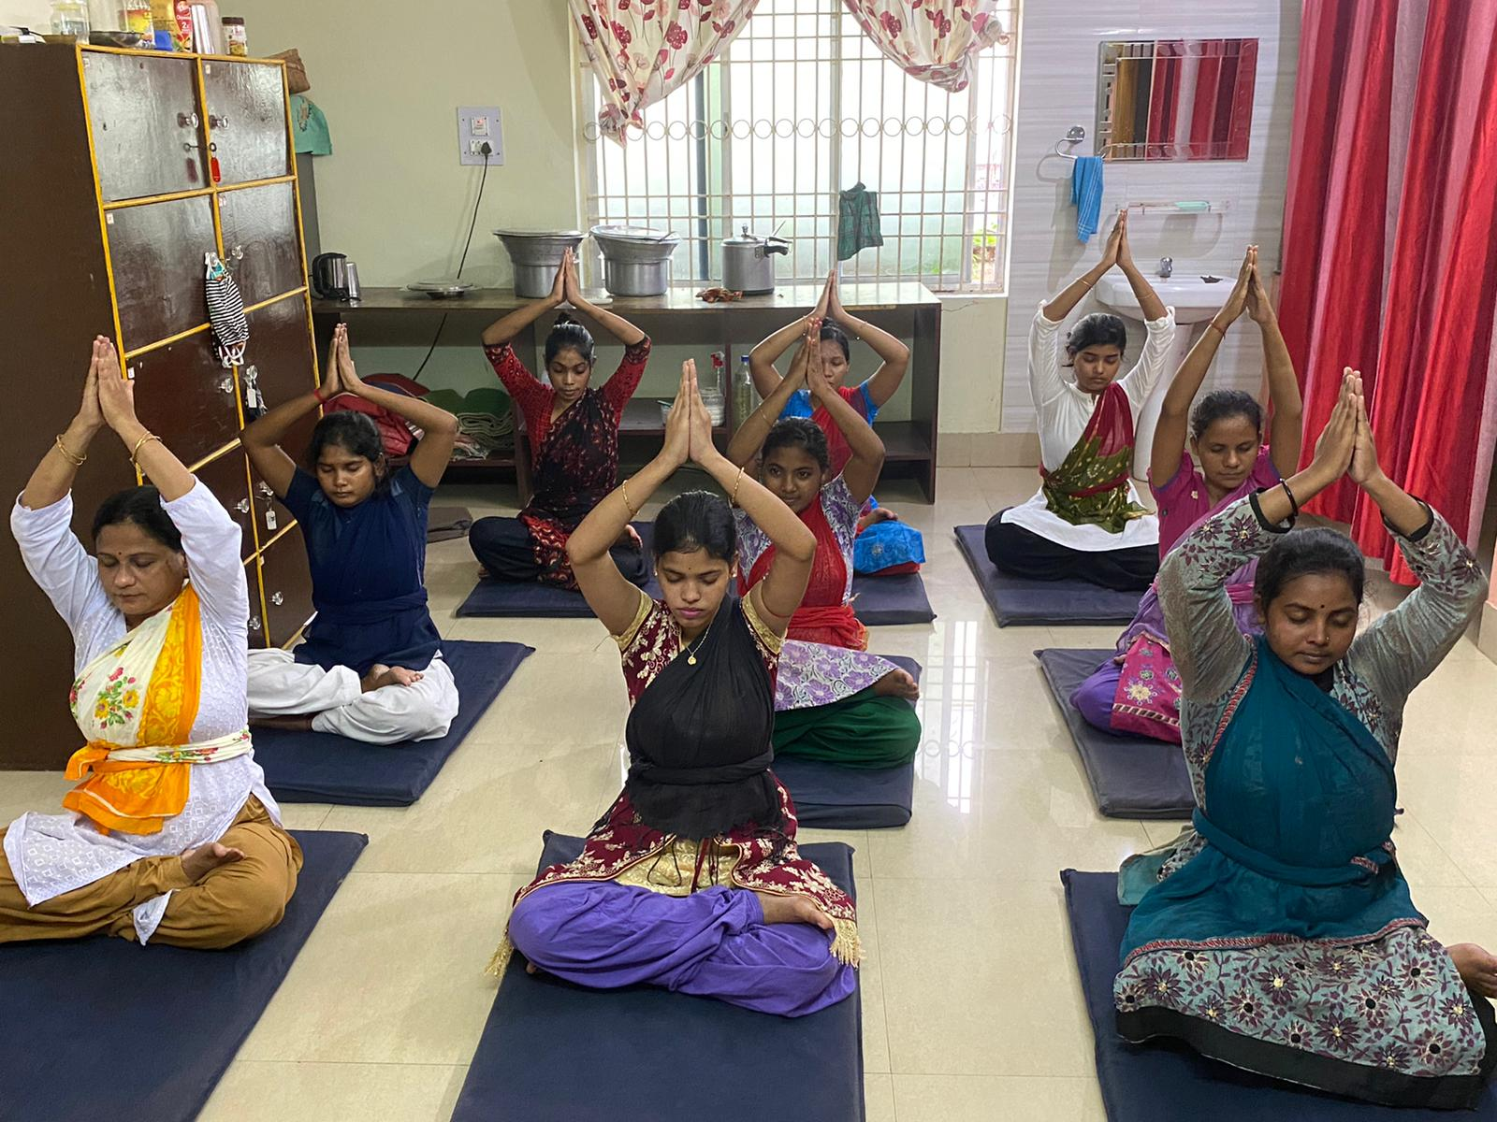
Life Skills Yoga

Slide 19
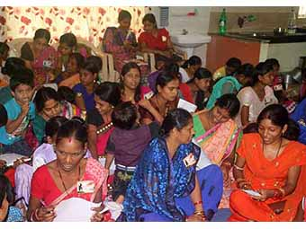
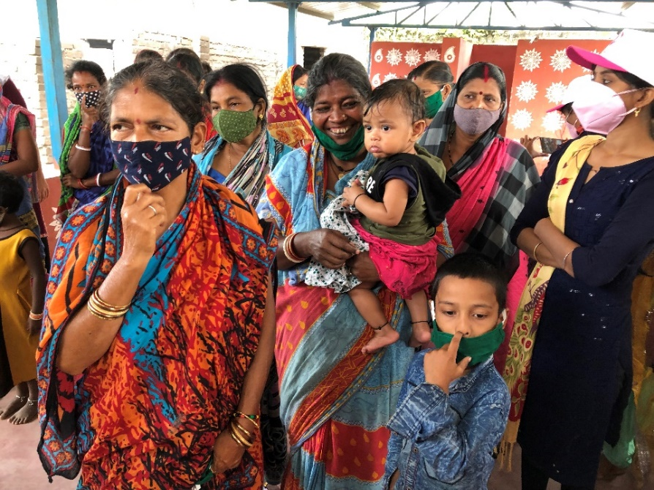
Workshops Women’s Social Issues
Domestic Violence
Drug & Alcohol
Pregnancy
Women’s Education
Divorce
Menstruation
Prostitution
Joint vs Nuclear Families
Rape & Sexual Abuse
Widows
Suicide
Abortion
Second Marriage
Menopause
Women in Politics
Childcare
Gender
Women in Sports
Women Traveling
Child Labor
Family Planning
Self-Defense
Mental Health
Live-in Relationships
Great Indian Women
Spiritual Life
Life Insurance
Women Infanticide
Adoption
Working Women
Independent Living
Single Mothers

Slide 20
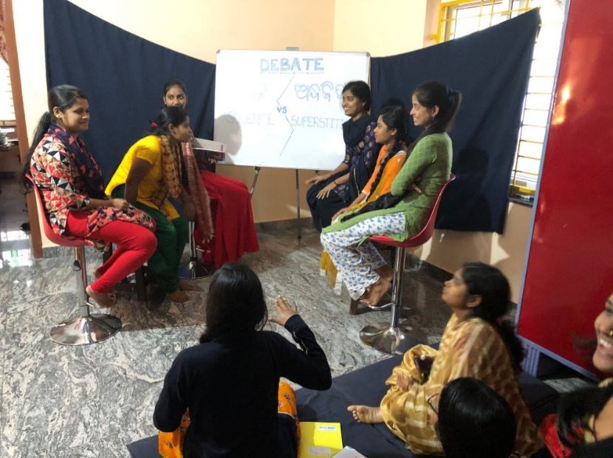
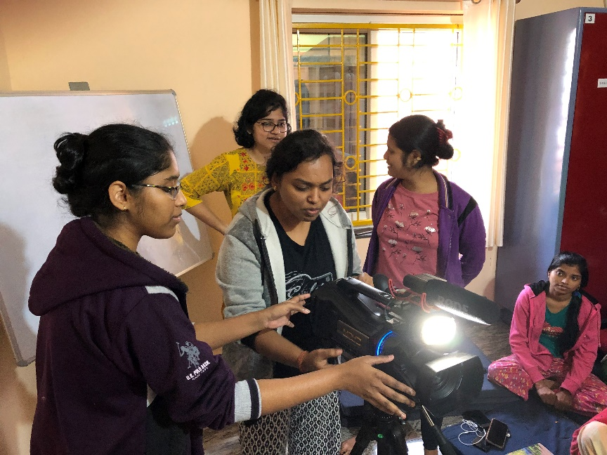
Internships
MA. and +3, First Division graduates majoring in Social Work, Rural Development and Psychology
Self-selected topics
Written Articles & Video Productions
Psychology, Social Work and Rural Development
Debates
Hands-on Work Experience
Certificates Issued Upon Successful Completion

Slide 21
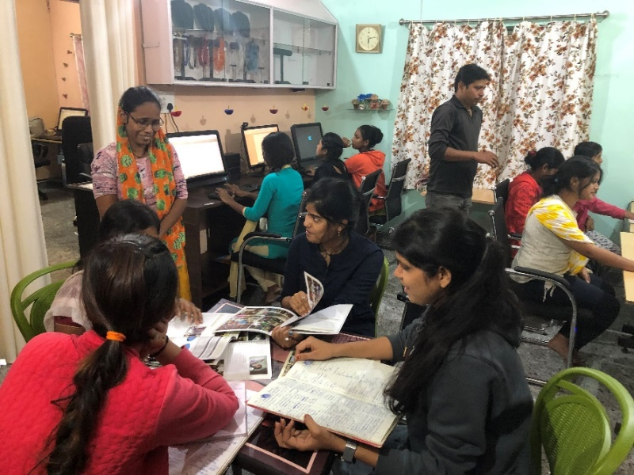
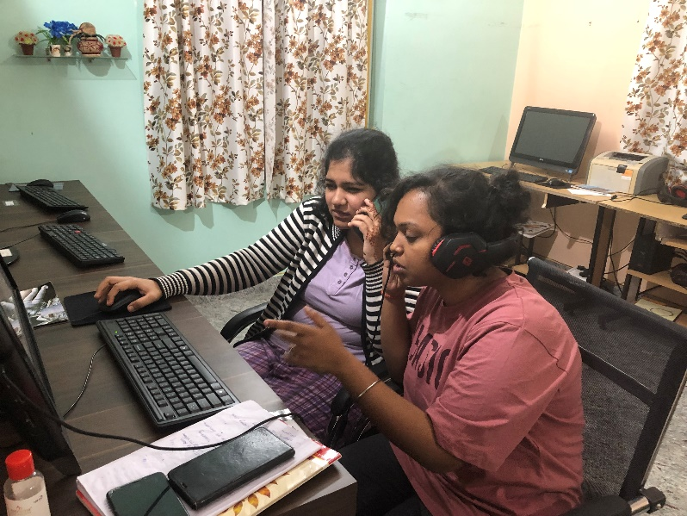
Internship Study Projects
Education Social Workers
Micro Enterprise
Drug & Alcohol
Mental Health
Human Trafficking
Domestic Violence
Water Resource Management
Government Schemes
Dropout Students’
Gender Issues
Learning Disabilities
Grief Counseling
Child Marriage
Acid Attack
Toxic Masculinity
Child Labor
Deforestation
Mental Health Counselling
Child Abuse
Women’s Rights
Medical Social Workers
Poverty in Villages
Dowry Prohibition
Adoption in India
Bonded Labor
Organic Farming
Abortion
Psychological Manipulation
Psychology of Terrorism
Cyber-Crime
Biodiversity

Slide 22
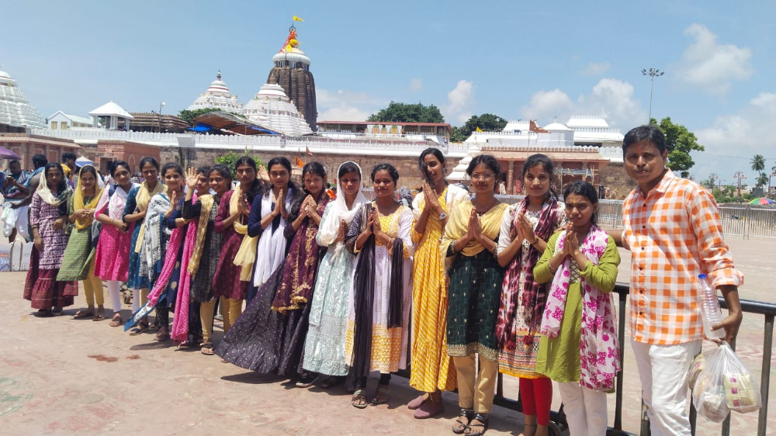
Special Events

Slide 23
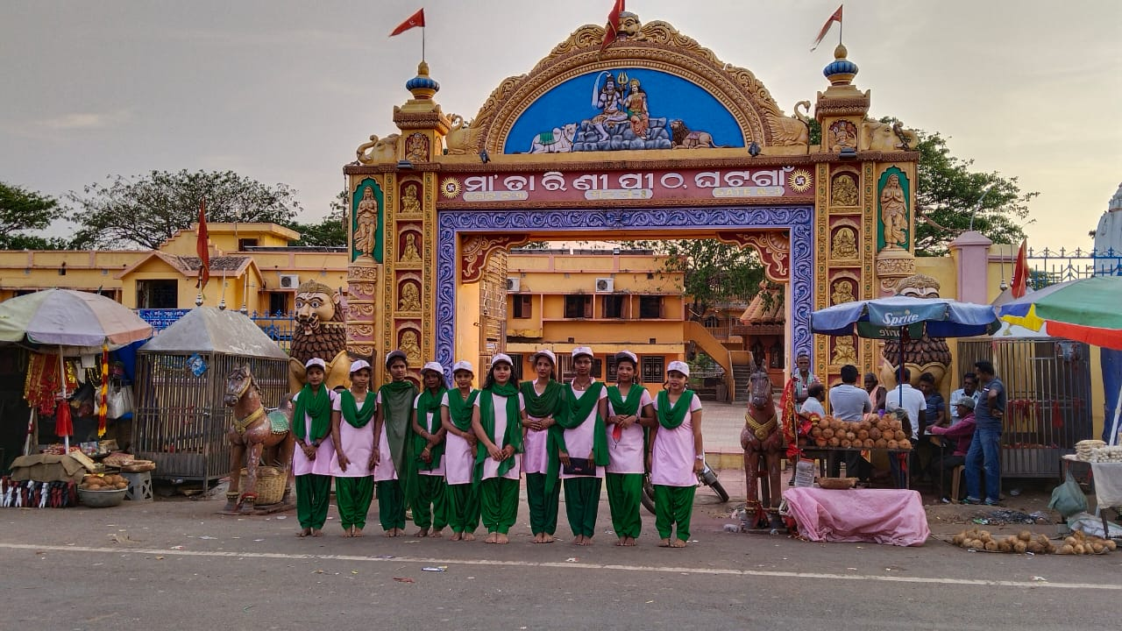
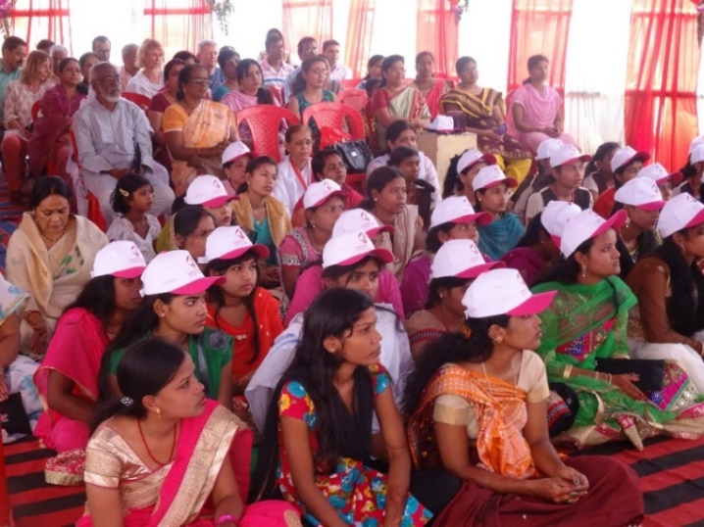
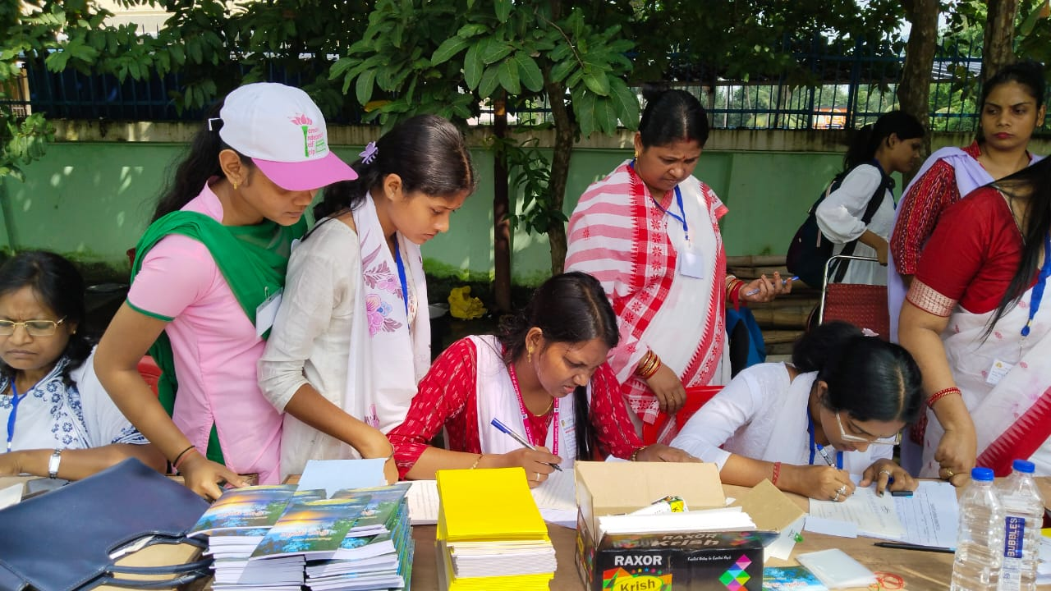
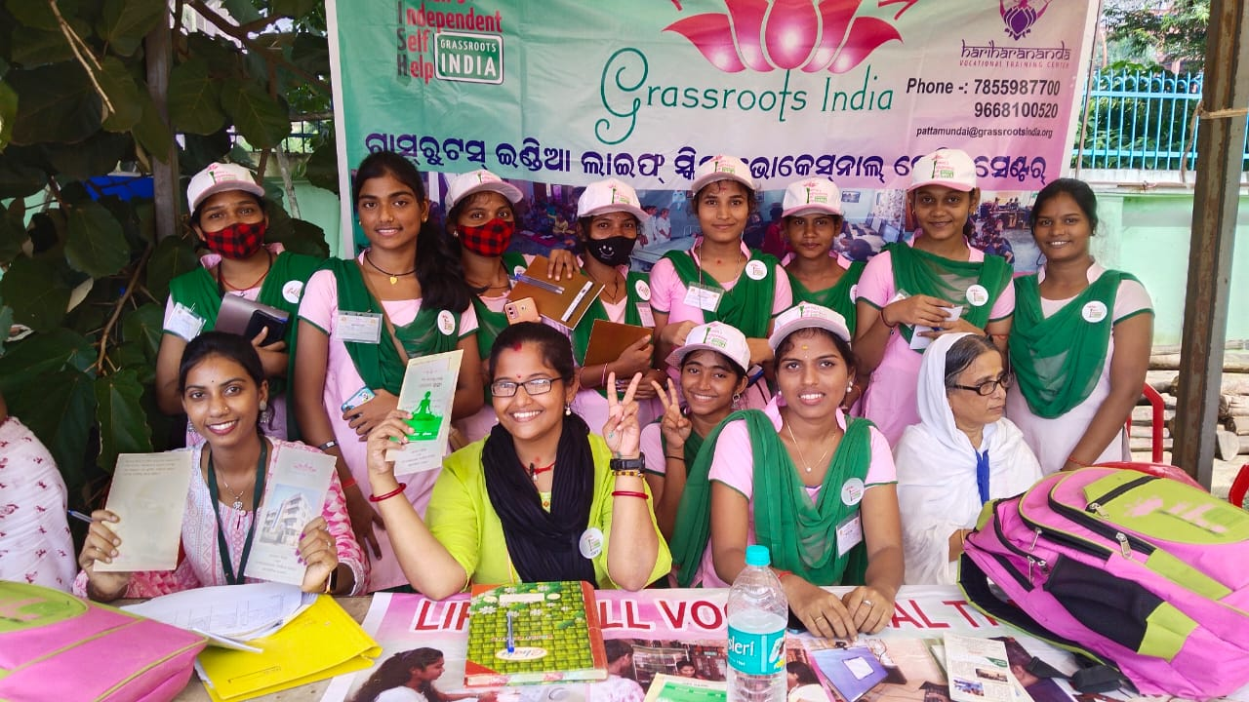
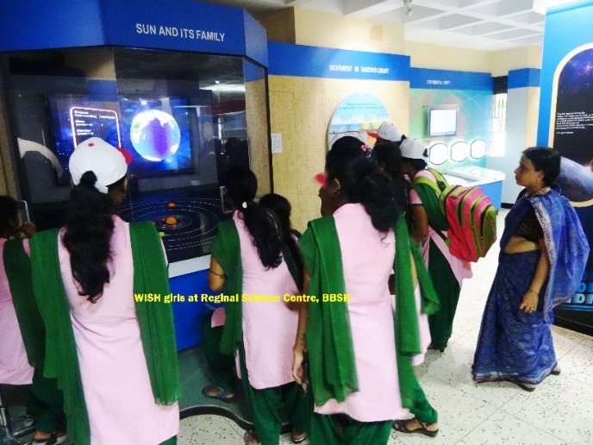
Foundation Day & Field Trips

Slide 24
Pujas & Festivals

Slide 25
Guest Speakers Doctors, Psychologists, Lawyers

Slide 26
In residence

Slide 27
Welcome to Grassroots India!

Slide 28
Five Dormitory Rooms plus Residential Staff Quarters

Slide 29
Five Dormitory Rooms & Residential Staff Quarters

Slide 30
Five Shared Bathrooms

Slide 31
Kitchen & Dining

Slide 32
Office Staff

Slide 33
Rooftops & Gardens

Slide 34
Education scholarships

Slide 35
Education Scholarships
Full and Partial Scholarships for
College Admission
Exam Fees
Textbooks
Hostel Fees
Staff assists with research, online admission procedures, and downloading exam results

Slide 36
Social services

Slide 37
Legal Aid Women’s Rights & Family Counseling

Slide 38
Village Outreach
Home Visits & Awareness Camps

Slide 39
College Programs

Slide 40
W.I.S.H. Village Change Agents

Slide 41
Mental Health Services

Slide 42
Upahar
Gifts of Love
From our Tailoring Class

Slide 43
Medical Aid & Patient Services
Meals on Wheels
Transportation & Logistics
Doctor Visits
Diagnostic Tests
Temporary Housing
Ambulance Services
Medicines
Assistant Nursing Internships

Slide 44
Medical Aid

Slide 45
Emergency Relief
Odisha has been subject to continuous natural disasters over the years leading to extensive environmental challenges.
Grassroots India routinely provides training, logistics, and aid to those suffering in times of emergency.

Slide 46
Job Placement & Group Housing
Students who receive certificates at Grassroots India easily retain jobs and often share a house or join a working girls hostel.

Slide 47
Plot No. 1427 CDA-10, Cuttack 0671-2309577 / 9668100520 office@grassrootsindia.org www.grassrootsindia.org

Slide 48
Plot No. 1427 CDA-10, Cuttack 0671-2309577 / 9668100520 office@grassrootsindia.org www.grassrootsindia.org

